Slide 1
Classifying PMGSY Scheme using Auto AI in Watsonx.ai
IBM AICTE PROJECT
Presented By:
Name : Ganta Kalyan
College: J N T University College Of Engineering Kakinada
Branch: Structural Engineering (MTech)

Slide 2
OUTLINE
Problem Statement
Proposed System/Solution
System Development Approach
Algorithm & Deployment
Result
Conclusion
Future Scope
References

Slide 3
Problem Statement
The Pradhan Mantri Gram Sadak Yojana (PMGSY) is a flagship rural development program in India aimed at providing all-weather road connectivity to unconnected rural habitations. Given the vast number of projects spanning multiple phases such as PMGSY-I, PMGSY-II, and RCPLWEA, there is a pressing need for efficient categorization of these projects. Manual classification of projects based on their physical and financial characteristics is time-consuming, error-prone, and unscalable, posing challenges for government bodies in effective monitoring, budget allocation, and policy-making.

Slide 4
Proposed Solution
The proposed system is designed to automatically classify rural infrastructure projects under the correct PMGSY scheme (e.g., PMGSY-I, PMGSY-II, RCPLWEA) based on physical and financial project attributes. The solution leverages machine learning techniques provided by IBM Watsonx.ai’s AutoAI feature to ensure accurate, scalable, and efficient classification. The goal is to assist infrastructure planners and policymakers in streamlining project monitoring and resource allocation.
The solution consists of the following components:
Data Collection: The dataset was sourced from the AI Kosh open government data platform. It includes attributes such as estimated cost, sanctioned amount, length of the road, type of project (road/bridge), and district information.
Data Preprocessing: AutoAI automatically handles missing values, categorical encoding, and normalization. Manual feature selection was minimized due to the automated feature engineering pipeline provided by AutoAI.

Slide 5
Model Training and Optimization: AutoAI trains multiple classification models such as XGBoost, LightGBM, Random Forest, and Logistic Regression. It evaluates these models using cross-validation and ranks them based on performance metrics like Accuracy and ROC-AUC.
Model Selection: The best-performing pipeline (typically XGBoost in this case) is selected based on evaluation metrics and is further used for deployment.
Deployment: The trained model is deployed on IBM Watson Machine Learning as a RESTful API, allowing real-time or batch predictions of project schemes based on input attributes.
Evaluation: The model's performance is evaluated using accuracy, precision, recall, and confusion matrix metrics within Watsonx.ai

Slide 6
System Approach
The solution is implemented using IBM Cloud Lite and Watsonx.ai platform. The steps involved are:
Data upload and preprocessing using Watson Studio
Use of AutoAI to build and evaluate models
Selection of best-performing model for deployment
Integration with IBM Cloud for model deployment and API generation
Technologies Used:
IBM Watsonx.ai
IBM Cloud Lite Services
AutoAI (AutoML)
Python (for any additional preprocessing)

Slide 7
Algorithm & Deployment
The AutoAI engine automatically evaluated multiple algorithms, including:
Gradient Boosting Classifier
Logistic Regression
XGBoost
Random Forest
After training and testing, AutoAI selected the best model based on weighted F1 score. The chosen
model was then deployed as a REST API on IBM Cloud. Steps:
Upload dataset to Watson Studio
Launch AutoAI experiment and select target column (PMGSY_SCHEME)
Let AutoAI generate pipelines
Evaluate metrics such as accuracy, F1-score, ROC-AUC
Deploy best model as web service

Slide 8
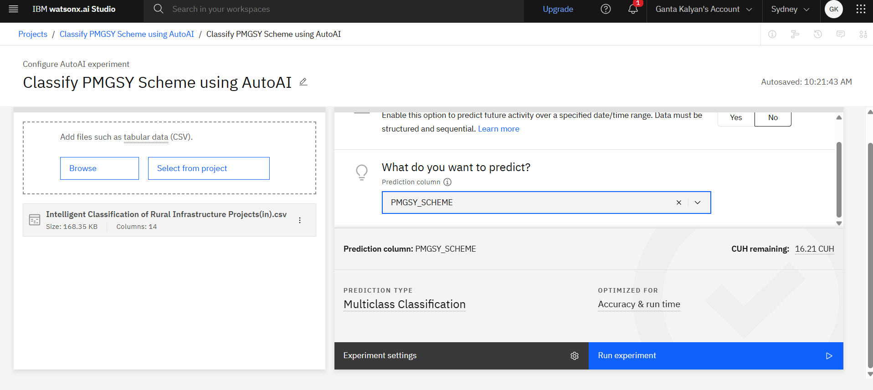
Result
The AutoAI pipeline achieved high accuracy and provided a deployable model. The confusion matrix and feature importance graphs are generated in the experiment dashboard.

Slide 9
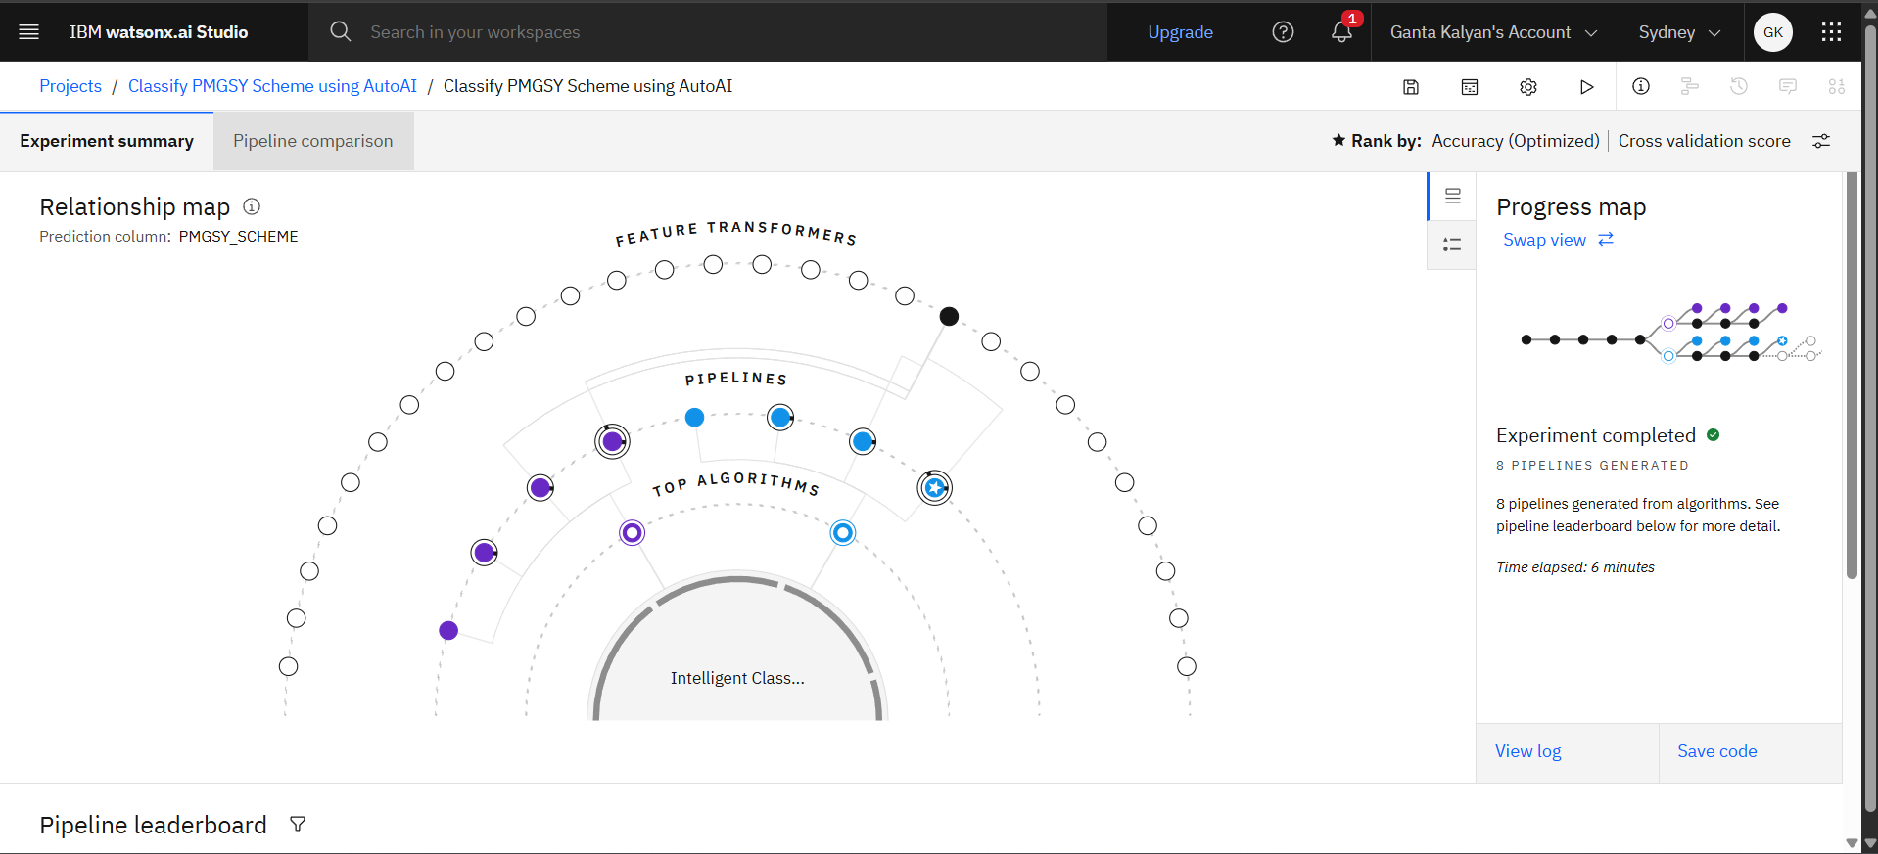
Result

Slide 10
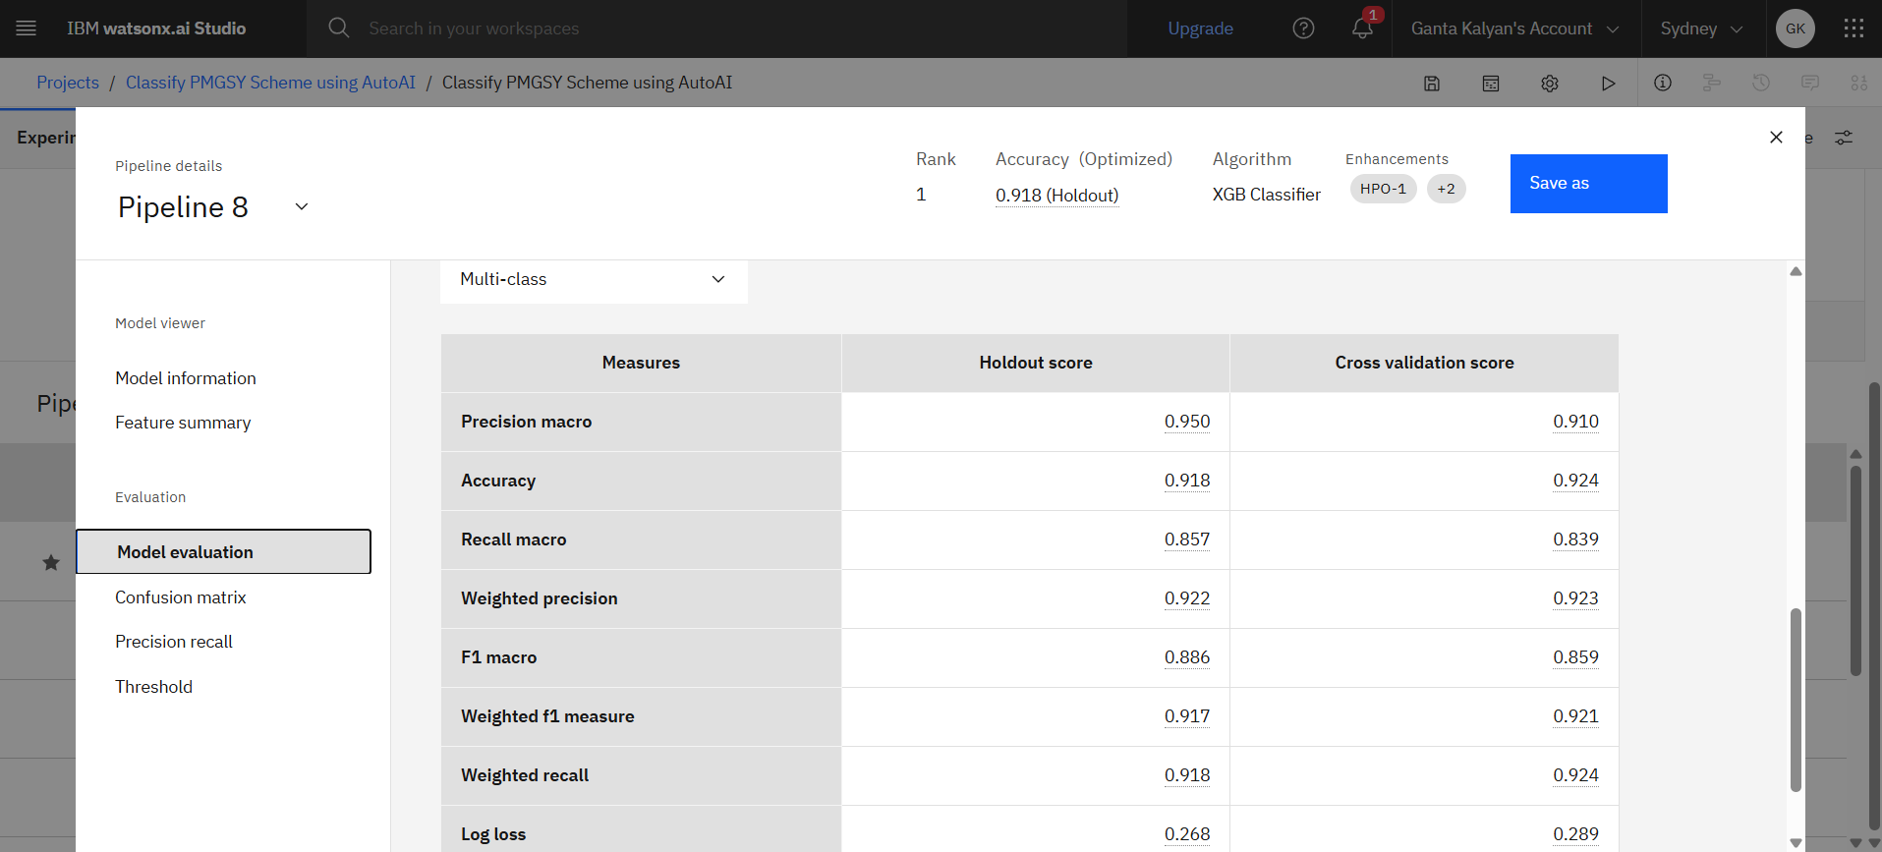
Result

Slide 11
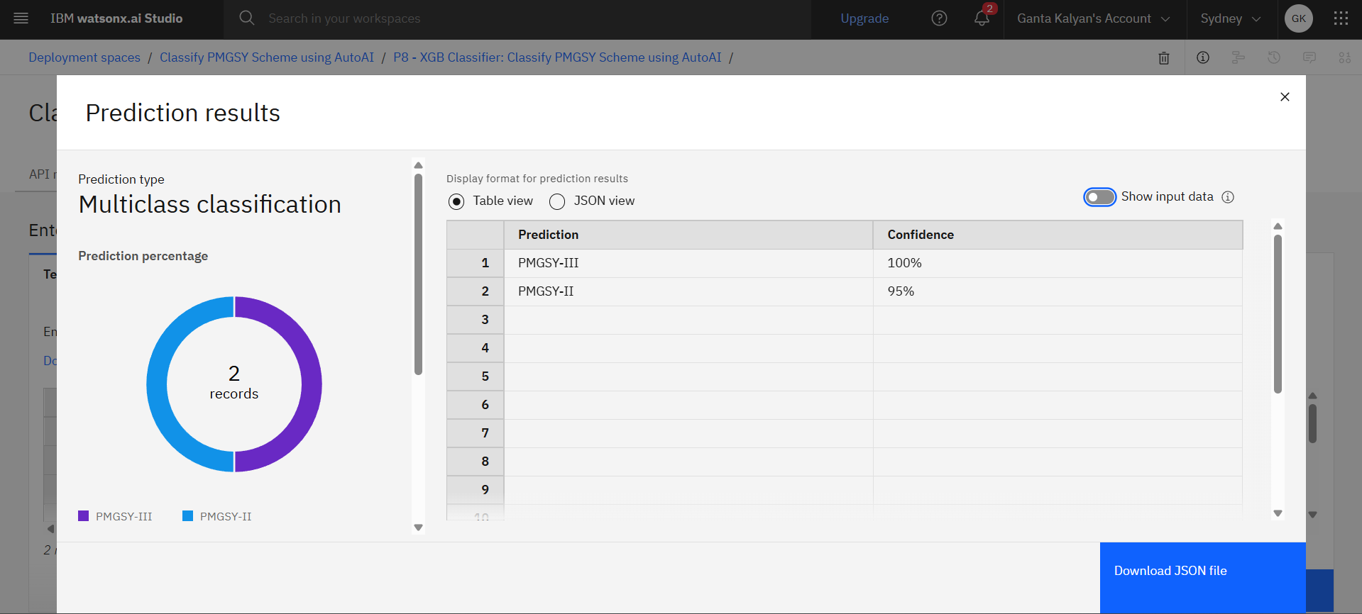
Result

Slide 12
Conclusion
The use of AutoAI significantly reduces the time and effort required to build a classification model for PMGSY scheme categorization. The deployed model is capable of classifying new project data with high accuracy, facilitating faster decision-making and better governance.
.

Slide 13
Future scope
The model can be enhanced by:
Integration of real-time classification during data entry by officials.
Expansion to other rural schemes such as BharatNet or Jal Jeevan Mission.
Use of explainable AI (XAI) to justify classification outcomes.
Incorporating geospatial features for better context-aware classification.

Slide 14
References
AI Kosh PMGSY Dataset
IBM Watsonx.ai Documentation – https://www.ibm.com/cloud/watsonx
PMGSY Official Site – https://pmgsy.nic.in

Slide 15
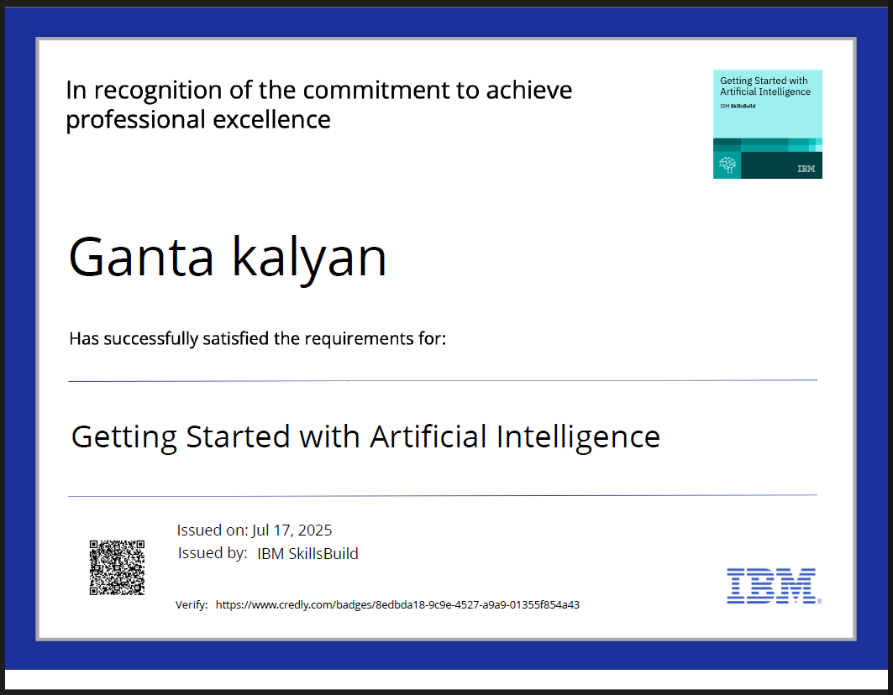
IBM Certifications

Slide 16
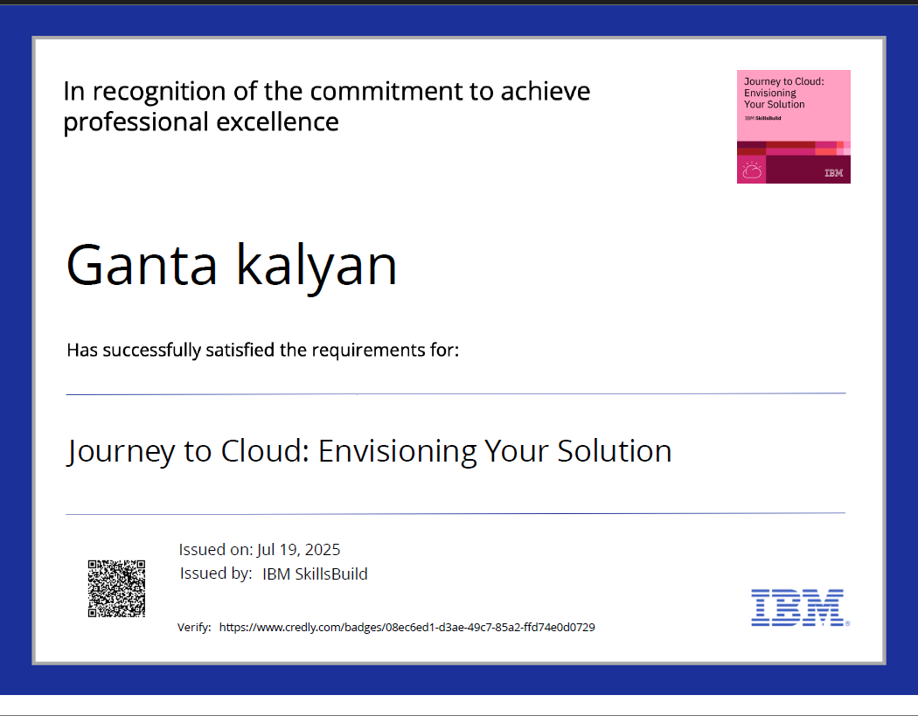
IBM Certifications

Slide 17
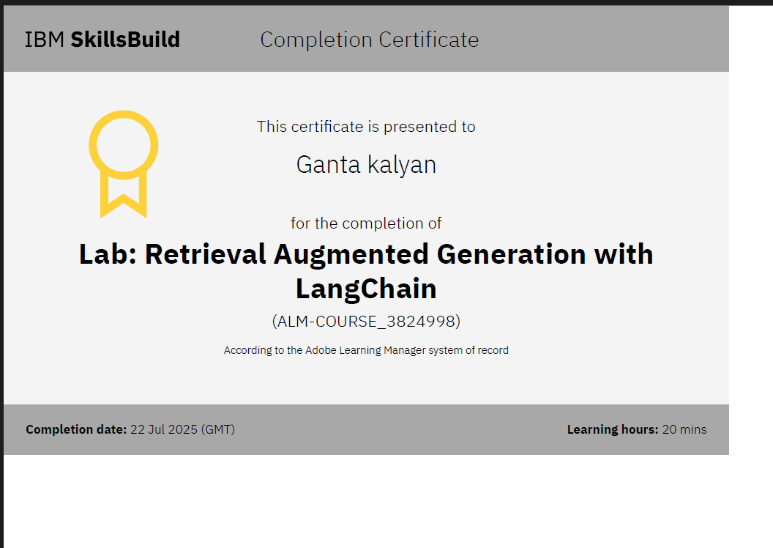
IBM Certifications

Slide 18
Github link :
https://github.com/GantaKalyan/IBM_Internship

Slide 19
THANK YOU

